Slide 1
The Battle Of The Neighborhoods
Lewis Gabell | IBM Data Science Capstone Project

Slide 2
Identifying the prime location for a Thai restaurant in England
Somchai wants to open his first ever Thai Restaurant in England, however, having never visited the country before, he has no idea as to where would be the best location to begin looking in. Can we identify the best location for his new business venture?
Notes:
This is the question that your experiment answers
2

Slide 3
Project Overview
Identify a location for a new Thai restaurant in England
The location must be in an area with a high Asian population
The location must not be in an area with other Thai restaurants in close proximity
The location must be in an area which is not densely populated with restaurants of any type

Slide 4
Methodology
Study
Gather
Sort and filter
Use
Study population data of England to determine which county of England will be the starting point for our analysis
Gather intel on the number and types of every venue in each borough within our chosen county
Sort and filter each borough based on their venues falling into the given criteria
Use machine learning to analyze the remaining 5 prime locations
Notes:
Summarize your research in three to five points.
4

Slide 5
DATA sources
Foursquare API for restaurant/venue information
Office of National Statistics for Ethnic Populating Data
http://martinjc.github.io For GeoJSON Data of England
Wikipedia for a list of London boroughs and lat/lon values

Slide 6
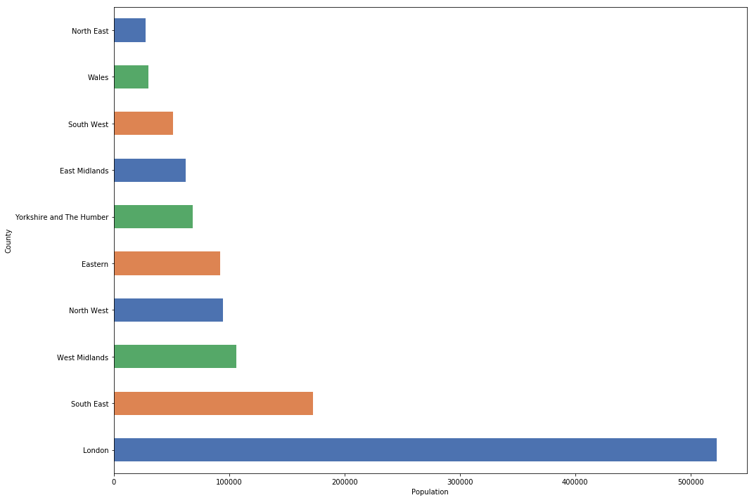
Asian Population in england
Data shows that London has a far bigger Asian (Chinese or Other) population than anywhere else in the country with approximately 523,000 citizens. This meant that London was our starting point for further exploration.

Slide 7
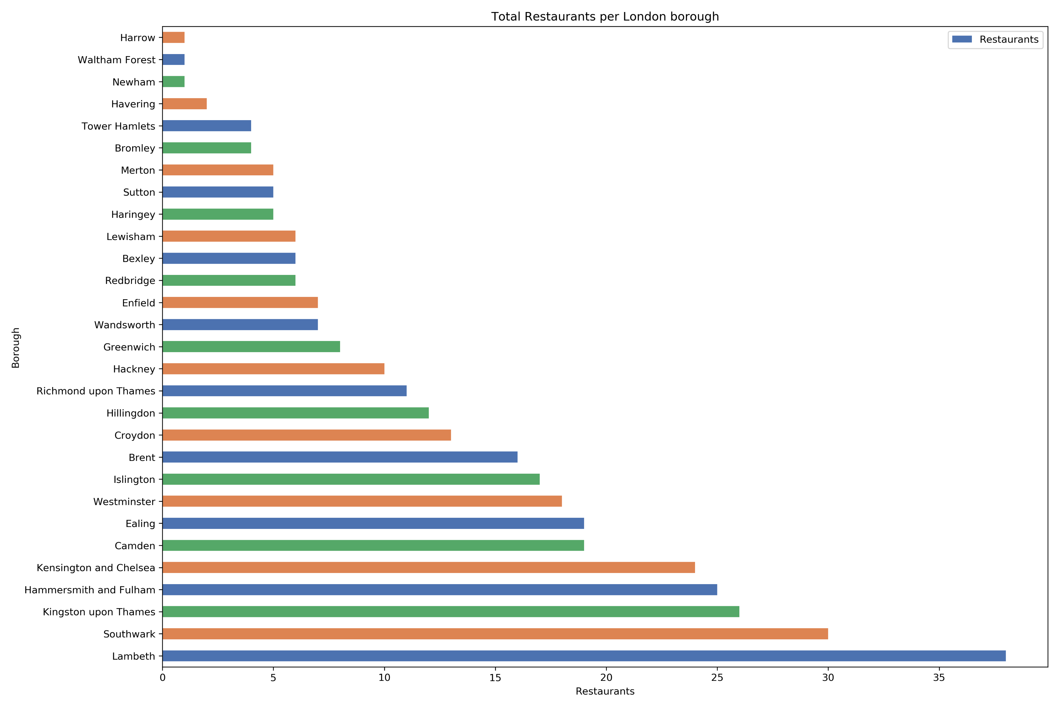
Venue discovery
After querying each of the 32 boroughs of London using the Foursquare API, we identified and gathered a list of locations for all 1,477 venues in London and, more specifically, the locations of all Thai and non-Thai restaurants in London too. We found that there was a total of 348 restaurants in London, 16 of which are Thai restaurants.

Slide 8
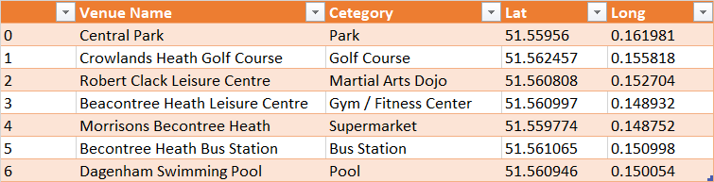
Venue discovery (continued)
Barking and Dagenham has a total of 7 venues, including a Park, a Gym and a Supermarket.

Slide 9
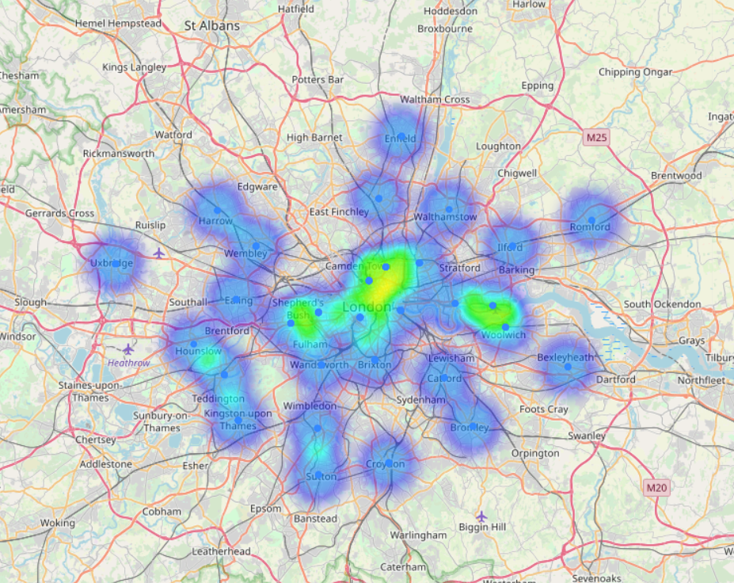
Restaurants in London
Using the data we could generate a heat-map of all restaurants in London to determine where the “hotspots” are.

Slide 10
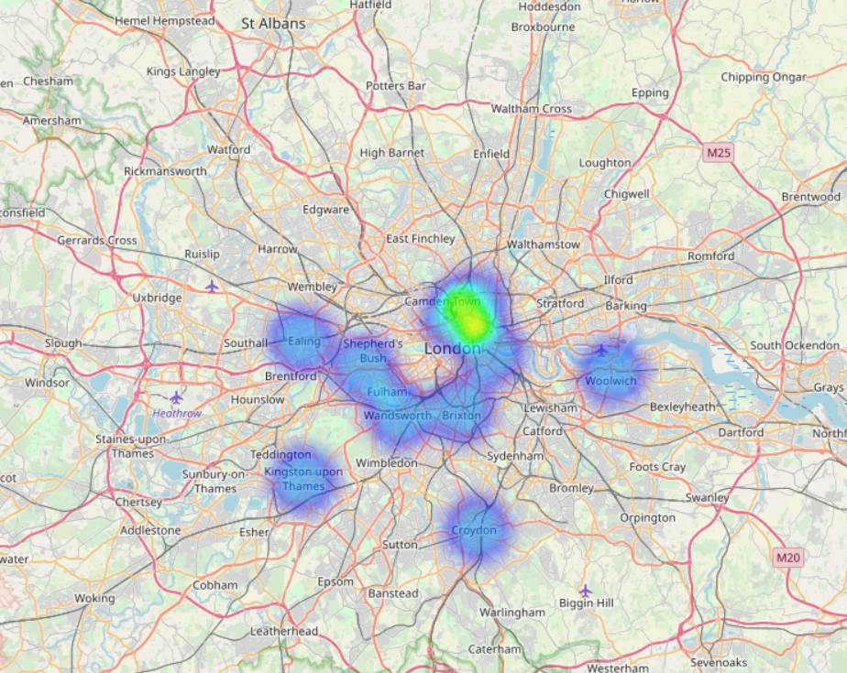
Thai Restaurants in London
Using the same data we could also generate a heat-map of all Thai restaurants in London to determine where the “hotspots” are.

Slide 11
Machine learning
Once the dataset was adequately filtered, machine learning was used to cluster each of the remaining 5 boroughs based on their similarity

Slide 12
Results
Our study managed to accurately find and select a series of locations which meet the business problem given by our client.
5 boroughs which had a high Asian population, the lowest restaurant density and also contained zero Thai restaurants were identified and probed.
Notes:
Establish hypothesis before you begin the experiment. This should be your best educated guess based on your research.
6

Slide 13
Conclusion
Population data of ethnic groups within the UK accurately identified London as the county with the highest Asian population, therefore London was selected for further probing.
Within London, each borough was analysed based on the number of venues, number of restaurants and number of Thai restaurants that they each contained.
These boroughs were then sorted and filtered based on the criteria given to leave just 5 boroughs which could be labelled as prime locations for the new restaurant.
Machine Learning was applied to the 5 selected boroughs to cluster each borough based on similarity and their 5 most common venues.
These 5 boroughs could now be put-forward to the client for his consideration and, if the client so wishes, each borough could be probed further using the same techniques on a more concentrated level.

